Slide 1


K.S SCHOOL OF ENGINEERING & MANAGEMENT, BENGALURU-560109
DEPARTMENT OF ELECTRONICS & COMMUNICATION ENGINEERING
INTERNSHIP /PROFESSIONAL PRACTICE (15EC84 )
“SMART GEYSER & MULTISIM”
Internship carried out at
Presented By
1KG16EC089
Shahid Khan A
ON 12-05-2020
Internal Internship Guide
Mrs. Kripa K B
Asst. Prof, ECE, KSSEM
External Internship Guide
Mr. Ravi Kumar
Access6 Technologies

Slide 2
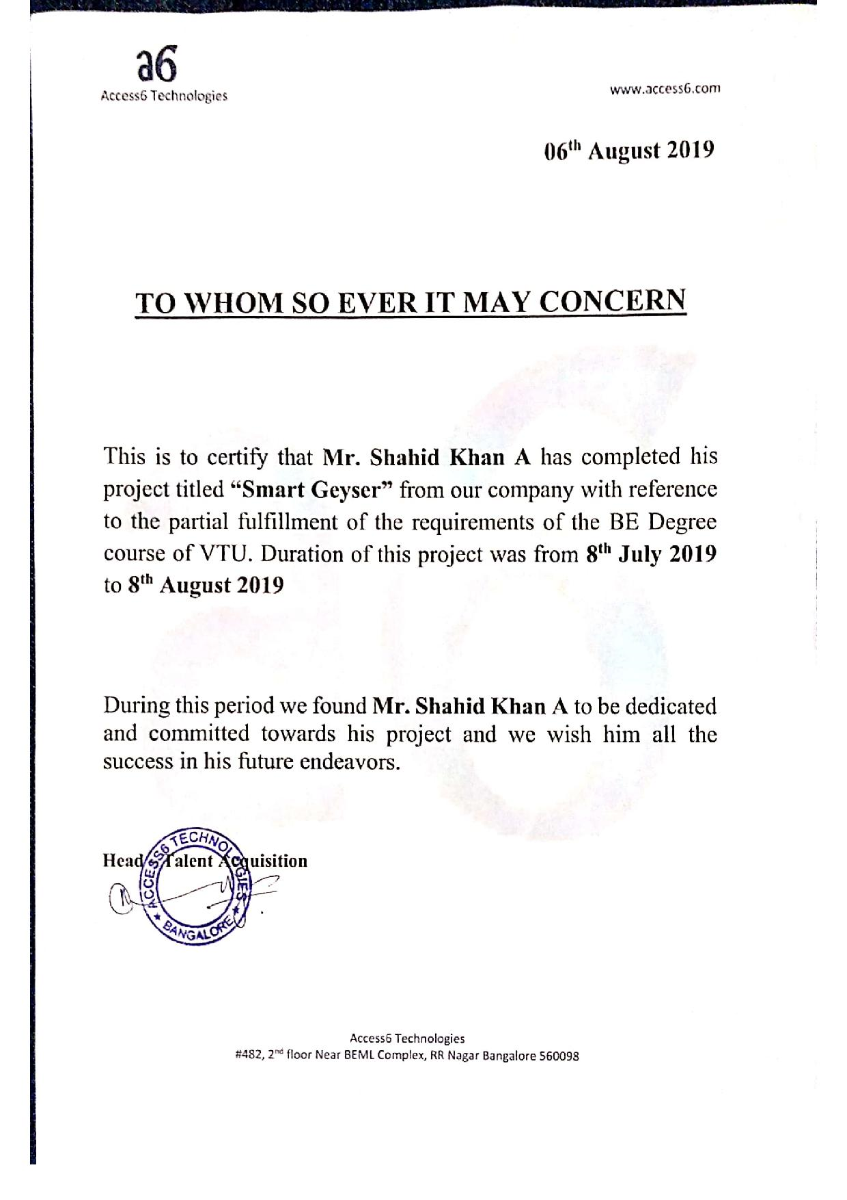
Internship Certificate

Slide 3
Outline
About Company
Work assigned
Introduction
Types of Geysers
Requirements for the system
Block Diagram, Working & Flow Chart
Multisim
Steps to build a circuit
Applications

Slide 4

About Company
Access6 is a Global Information and Technology Company. We have clear philosophy of “Connecting Dots…” which aims to do business and provide complete satisfaction to customers by practicing best practices by understanding the business needs and providing subsequent solution to the Clients, we aim to evolve as a complete and ‘One Stop Information and Technology Company’.

Slide 5
Company Offers
Access6 Technologies offers:
Products Development
IoT
ERP
CRM
Web Applications
Android, IOS and Hybrid
Trainings
College to Campus
Technology
Non IT
Management
HTD- Hire Train Deploy
Online
Staffing and Placements
Graduate Hire
Technology Specific
Project Specific
Experienced- Technical
Our extensive partner network helps us drive collaboration and leverage technology Independence. We work on industry- leading solutions like Amazon Web Services, HP, IBM, Informatica, Microsoft, Oracle, Opensource tools and etc…

Slide 6
Work Assigned
To design a smart geyser which simplifies the mixing of cold water which is required to reduce the temperature as per his/her requirements.
Objectives:
To achieve the real-time monitoring and control of the system.
To switch to upgrading technology.
To save time and energy.

Slide 7
Introduction
Water heating is a heat transfer process that uses an energy source to heat water above its initial temperature.
Typical domestic uses of hot water include cooking, cleaning, bathing, and more. In industry, hot water and water heated to steam have many uses.
Today, there is the newest addition to the many types of water heaters which is the Smart Water Heater.
Like other smart devices, they are connected to a gateway, making them accessible via your smartphone.

Slide 8

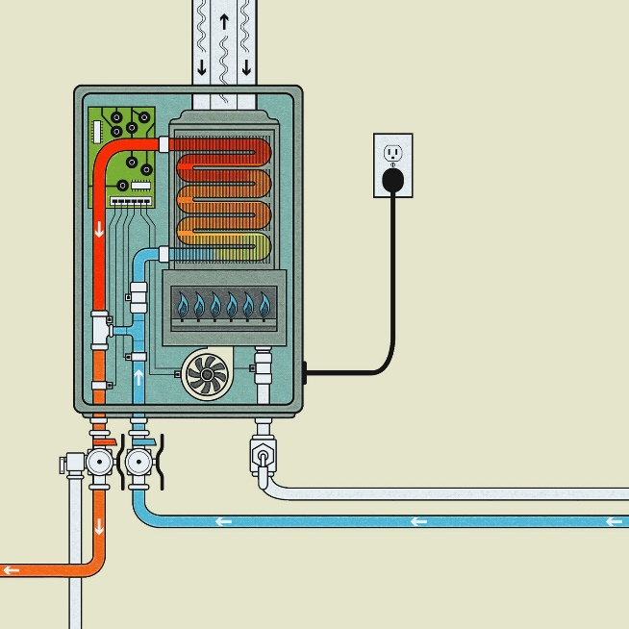
Types of Geysers
Tank Water Heaters 2. Tank-less Water Heaters

Slide 9
Requirements for the System
Hardware Components Software Requirement
Arduino UNO → Arduino software
Seven Segment display
Buzzer
Fingerprint Scanner Online Tool used
PIR Sensor → Circuito.io
Temperature Sensor
NodeMCU ESP8266
Voice Recognition module
Thermostat

Slide 10
Block Diagram
POWER SUPPLY
FINGERPRINT SENSOR
ARDUINO UNO
VOICE RECOGNITION MODULE
SEVEN SEGMENT DISPLAY
NODEMCU
ESP8266
BUZZER
Internet
TEMPERATURE SENSOR
THERMOSTAT
PIR SENSOR

Slide 11








Working Principle

Slide 12
Flow Chart
Start
Finger Print Scanner scans for the input
If the data is not stored, user can enter the temperature manually
PIR sensor senses the motion and the lights are turned on
Voice recognition module reminds about the default temperature set
Seven Segment Display
Using thermostat water is obtained of the required temperature
Stop

Slide 13
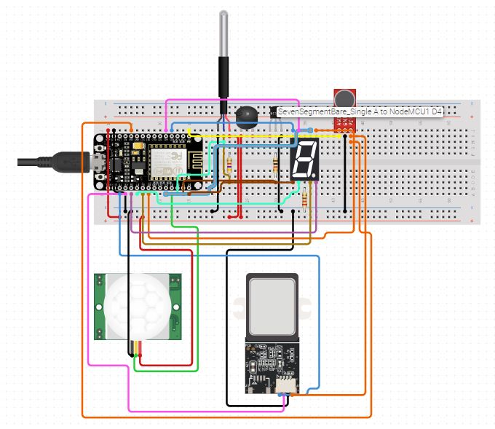

Slide 14
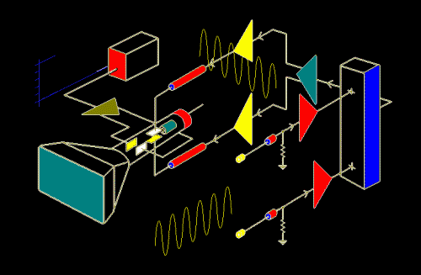
MULTISIM
What is Multisim?
Multisim is industry-standard SPICE simulation and circuit design software for analog, digital, and power electronics in education and research.
SPICE- Simulation Program with Integrated Circuit Emphasis
It is a general-purpose, open-source analog electronic circuit simulator. It is a program used in integrated circuit and board-level design to check the integrity of circuit designs and to predict circuit behavior.

Slide 15
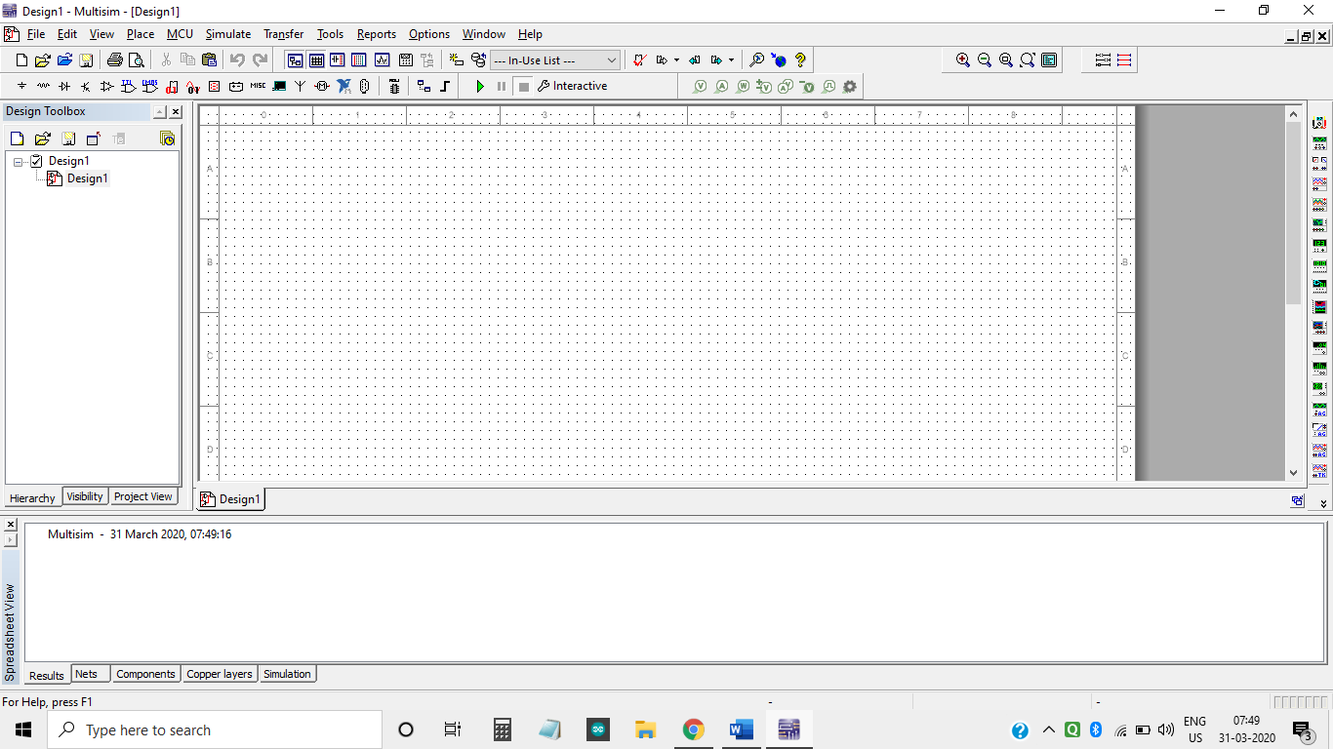
Multisim Interface
TOOLBARS
WORKSPACE
DESIGN TOOLBOX

Slide 16
Toolbars
Multisim includes a number of toolbars to assist in performing numerous operations.
Standard Toolbar
Main Toolbar
Simulation Toolbar
View Toolbar
Components Toolbar
Place Probe Toolbar
Virtual Toolbar
Graphic Annotation Toolbar
Instruments Toolbar
Locking Toolbars
Toolbar Behavior when Multisim size is reduced

Slide 17
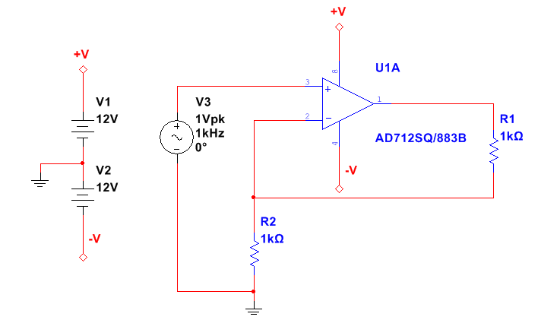
Steps to build a circuit
The example circuit is an amplifier circuit. This non-inverting operational amplifier configuration consists of one active component (the operational amplifier) and two passive resistor components that will be used to complete the feedback network to provide gain in this circuit.
Introduction
The gain of this non-inverting amplifier is calculated by the expression Gain = 1 + R1/R2. Therefore, if R1 = R2, then the gain is equal to 2, which you will verify when you run interactive simulation in Multisim.

Slide 18
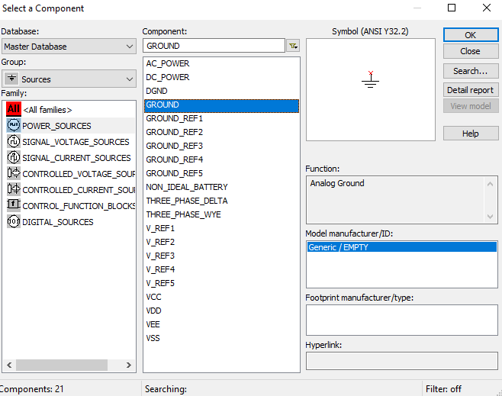
Step 1: Selecting the components
Select Place → Component. The Select a component window appears as shown below

Slide 19
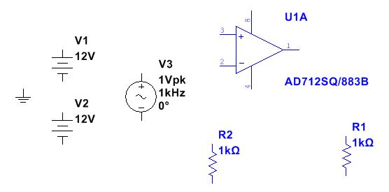
Select and place the components in the workspace keeping the circuit as the reference.
Note: You can rotate a component before placement by using the <Ctrl+R> shortcut on your keyboard when the component is ghosted to the mouse pointer.
After placing the components, the schematic should look something like the Figure below:

Slide 20
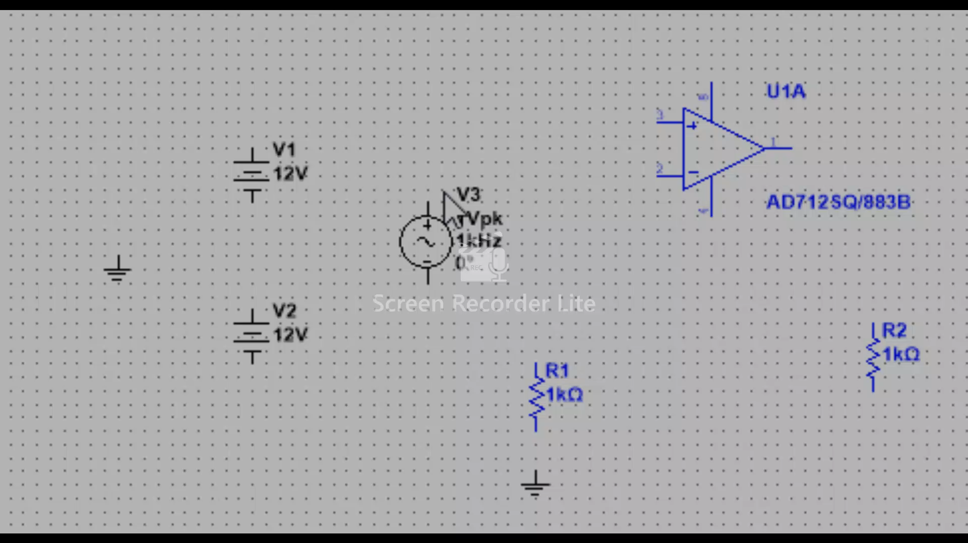
Step 2: Wiring the schematic
Multisim is a modeless wiring environment. This means that Multisim determines the functionality of the mouse pointer by the position of the mouse. You do not have to return to the menu to select between the placement, wiring, and editing tools.

Slide 21
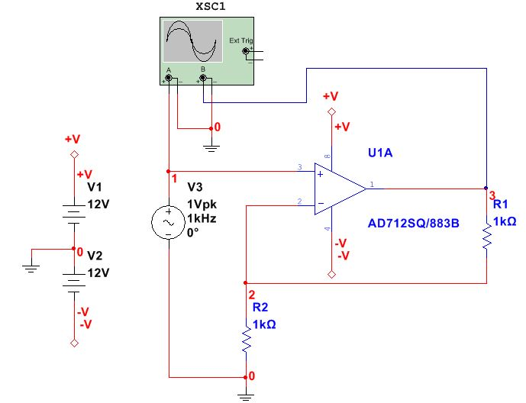
Step 3: Simulating the circuit
Multisim provides instruments to visualize the simulated measurements.
Select the Oscilloscope from the Instruments toolbar and place this onto the schematic.
Wire the Channel A and Channel B terminals of the Oscilloscope to both the input and output of the amplifier circuit.
Place a ground component and connect it to the negative terminals of the Oscilloscope.

Slide 22
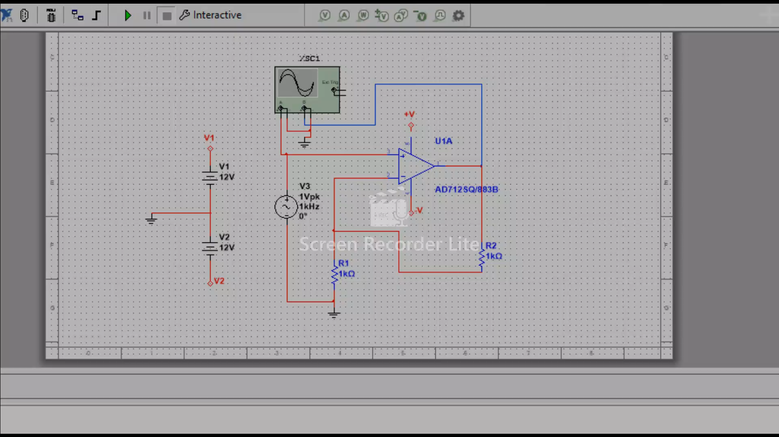
Select Simulate → Run to start the simulation.
Double-click on the Oscilloscope to open its Front Panel and observe the simulation results. As expected, the input signal is being amplified by a factor of 2.

Slide 23
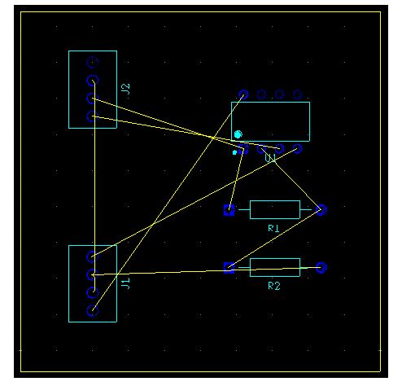
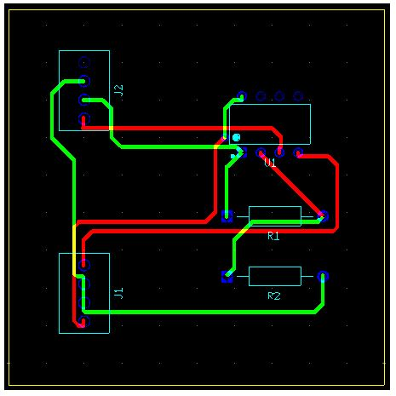
Step 4: transferring to PCB layout
Select Transfer → Transfer to Ultiboard → Transfer to Ultiboard 14.0
Step 5: Routing the board
Placing Traces

Slide 24
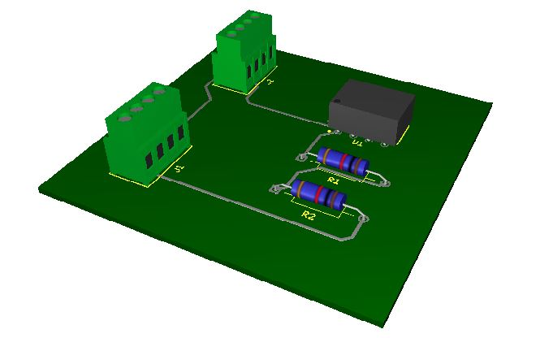
Select View → 3D Preview to open a 3D view of your design, as show below

Slide 25
Applications of NI Multisim
Life Science, Medical Devices, and Bioinstrumentation Applications
Low-Frequency Circuit Design for RF Applications
Automotive Electronics Applications

Slide 26
CONCLUSION
To implement a new real time project called ‘smart geyser’, we have designed a flow chart and architecture of a system. which tells us about working and overall outcome.
This incorporates different types of sensors, and wireless technologies like Wi-Fi, Bluetooth network with custom application software, fixtures and enclosures to construct the complete test system.
Multisim helps us easily visualize and understand the behavior of electronics with 30+ intuitive simulated instruments.

Slide 27
Thank you

